Slide 1

Analyzing Digital Piracy
Consumer Behavior and Industry Impact and Policy Implications.
Group No 2.(MCA)
Authors – Dr. Sanju Gupta
Shubham Ambrale (04)
Sahil More(42)
Presented By –
Sahil More & Shubham Ambrale

Slide 2
Abstract
Analyzes consumer behavior and motivations behind digital piracy.
Evaluates the economic impact of piracy on entertainment and software industries.
Investigates correlations between piracy trends and economic outcomes using a hypothesis-driven approach.
Assesses the effectiveness of anti-piracy strategies and proposes policy recommendations.

Slide 3
Introduction -
What is Digital Piracy?
Digital piracy refers to the unauthorized access, copying, distribution, and sharing of copyrighted digital content. This includes movies, music, e-books, video games, and software. With the rise of the internet, piracy has become a widespread issue, affecting multiple industries and economies globally.
Why is it a Concern?
It reduces revenue for content creators, industries, and governments.
It raises ethical and moral questions about intellectual property rights.
It leads to legal consequences for individuals and businesses involved.
This presentation aims to analyze digital piracy through consumer behavior, economic impact, and policy responses.

Slide 4
Literature Review
Understanding Consumer’s Digital Privacy Behavior (Koay & Chin-Hooi, 2024) examines how privacy concerns affect piracy habits.
Online Piracy and Consumer Affect: To Pay or Not to Pay (Kampmann, 2009) explores psychological factors influencing consumer choices regarding piracy.
Impact of Online Digital Piracy on the Indian Film Industry (Chawla & Buch, 2023) highlights how piracy disrupts the film market.
Why Do Individuals Use Online Video Piracy Websites? (Kim & Kim, 2024) identifies reasons for the preference for illegal streaming.
Music Piracy and Its Effects on Demand, Supply, and Welfare (Waldfogel, 2006) analyzes how piracy affects market dynamics.

Slide 5
Research Gap
While many studies address digital piracy, most focus individually on economic or legal perspectives.
There is limited integrated analysis combining consumer behavior, economic loss, and policy effectiveness.
Emerging technologies like blockchain and AI in anti-piracy measures remain underexplored.

Slide 6
Scope
Analyzes consumer motivations and behaviors toward digital piracy.
Explores the economic impact on industries like film, music, and software.
Evaluates the effectiveness of legal and technological interventions.
Suggests multi-dimensional policy recommendations combining education, affordability, and enforcement.

Slide 7
Objectives of the Research
To analyze consumer behavior and psychological factors driving digital piracy.
To evaluate the economic impact of piracy on the entertainment and software industries.
To examine the role of legal streaming services in reducing piracy rates.
To assess the effectiveness of anti-piracy laws and technologies, including blockchain and AI.
To recommend balanced policy interventions combining accessibility, education, and enforcement

Slide 8
Research methodology
Type of Study: Descriptive and analytical
Methodology: Qualitative and quantitative (mixed-method approach)
Data Type: Secondary data (from published research, reports, articles)
Tools Used: Statistical graphs, comparative analysis.

Slide 9
Research methodology
Sources & Analysis:
Data Sources:
Peer-reviewed journals
Industry reports (film, music, software)
Survey-based studies(Secondary Data.)
Analytical Methods:
Trend analysis (consumer behavior, piracy rates)
Hypothesis testing (e.g., impact of income, streaming services)
Case studies (Indian film industry, software sector)
Graphical Representations:
Bar charts, line graphs

Slide 10
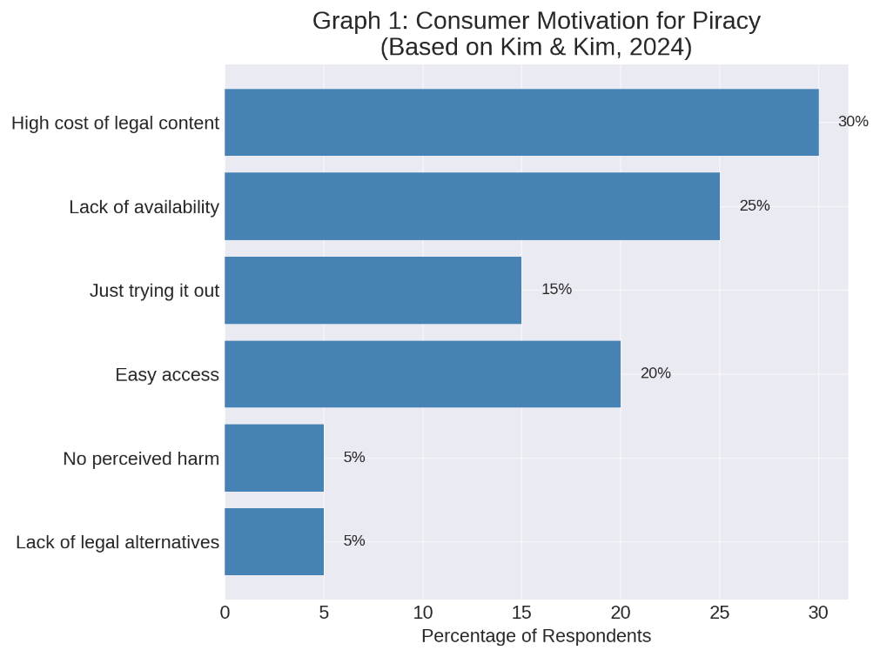
Data Analysis and Interpretations:
Consumer Behavior Toward Piracy
Key Factors Influencing Piracy:
Affordability and ease of access
Age group: Younger demographics more prone
(Arli, 2016)
Perception that piracy is a “victimless crime”

Slide 11
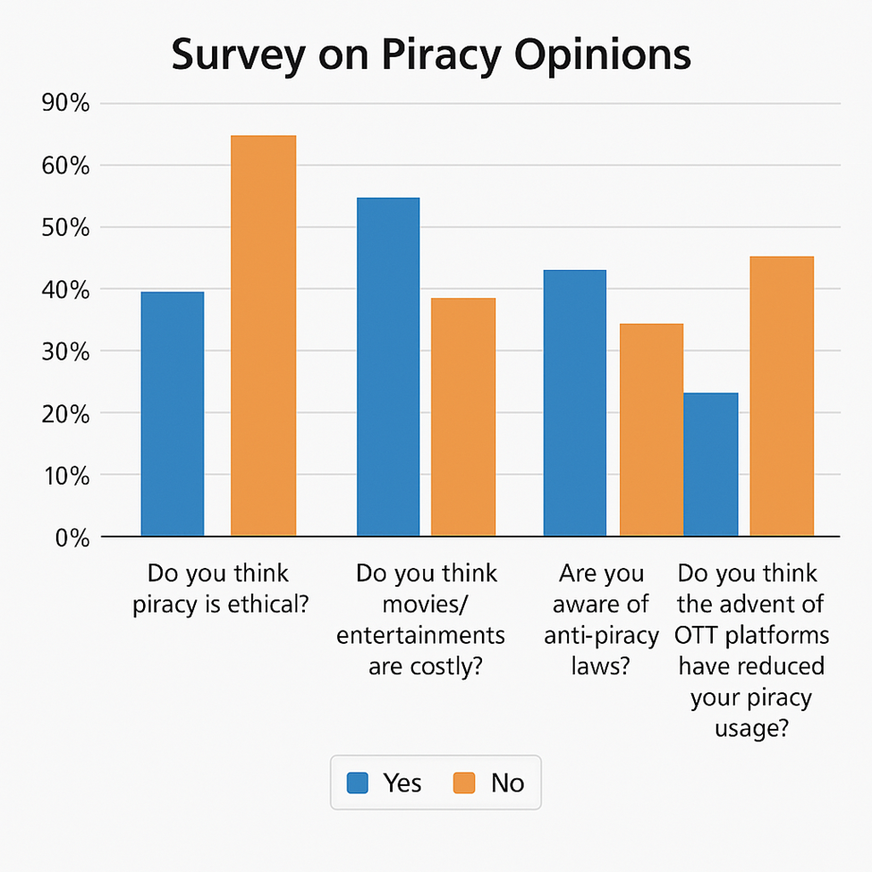
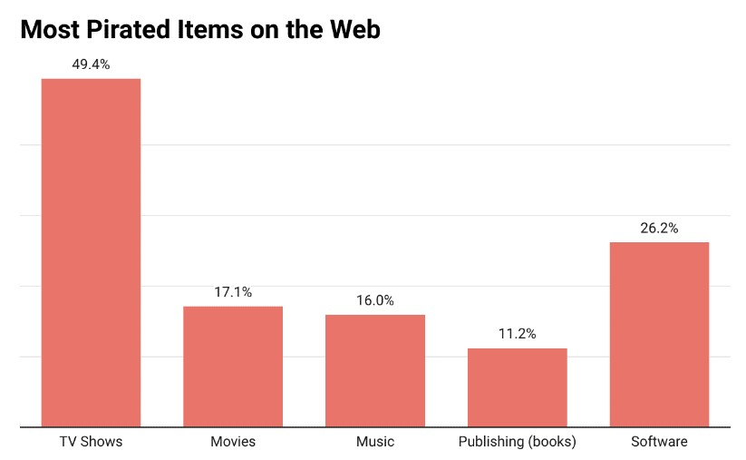
Data Analysis and Interpretations:
Consumer Behavior Toward Piracy

Slide 12
Data Analysis and Interpretations:
Findings:
Anti-piracy laws exist but often ineffective
Users bypass restrictions using VPNs.
Interpretation: Enforcement alone is not a sustainable solution; tech-savvy users find workarounds
Need for tech-driven and behavioral solutions (DRM, blockchain)
Netflix, Spotify, etc. have reduced piracy rates significantly
Supports Hypothesis H2: Affordable alternatives reduce piracy
Making content accessible and affordable is more effective than punishment

Slide 13
Future Strategies for Reducing Piracy
Enhancing User Experience:
Ensuring high-quality streaming services with minimal buffering to compete with pirated content.
Introducing offline viewing options to cater to users with poor internet access.
Case Study:
The launch of Netflix, Spotify, and Apple Music significantly reduced piracy rates by making content more accessible and affordable.
Case Study:
Netflix & Amazon Prime use AI-based piracy detection and DRM to secure their content and reduce illegal downloads.

Slide 14
Educating Consumers on the Impact of Piracy
Many consumers, especially in developing countries, do not fully understand the consequences of piracy. They often believe that piracy does not cause significant harm.
Key Solutions:
Public Awareness Campaigns:
Governments and industries should run educational campaigns highlighting how piracy affects artists, game developers, and movie studios.
Example: The “You Wouldn’t Steal a Car” anti-piracy ad campaign aimed at raising awareness about copyright theft.
Changing Perceptions Through Social Media:
Influencers and celebrities can promote legal alternatives and emphasize fair payment for artists.

Slide 15
Conclusion
Digital piracy is a multifaceted challenge influenced by affordability,
accessibility, and consumer mindset.
Legal enforcement alone is insufficient; consumers often find workarounds like VPNs.
Availability of affordable legal alternatives significantly reduces piracy rates.
Piracy impacts industry revenues, creative freedom, and content investment.
A combination of technological innovation, policy reform, and consumer awareness is
essential to curb piracy.

Slide 16
Recommendation
Introduce flexible, affordable legal streaming models (ad-supported, student plans, etc.)
Use blockchain and AI for real-time piracy detection and copyright tracking
Implement digital watermarking and DRM for better content protection
Launch awareness campaigns in schools, colleges, and on social media
Reform copyright policies to balance enforcement with accessibility
Encourage industry collaboration (media, ISPs, tech firms) for unified action
Support independent creators through fair revenue-sharing models

Slide 17
References
Koay, K.Y., & Chin-Hooi, P. (2024). Understanding Consumer’s
Digital Privacy Behavior. Research Gate.
Kampmann, M. W. (2009). Online Piracy and Consumer Affect: To Pay or
Not to Pay. University of Twente.
Chawla, G., & Buch, N. (2023). Impact of Online Digital Piracy on the Indian Film
Industry. NiscPr.
Kim, M. S., & Kim, S. (2024). Why Do Individuals Use Online Video Piracy
Websites?. Science Direct.
Waldfogel, J. (2006). Music Piracy and Its Effects on Demand, Supply,
and Welfare. University of Chicago Press..

Slide 18
/
THANKYOU

